Slide 1
DIC Final Project Presentation
32-Rows x 4-Columns Digital Computation-in-Memory Macro for Matrix Multiplications
Group members：黃之辰、賴薪雅、陳卿雅、陳昕
Student ID：312514043、312514059、313581036、313514081

Slide 2
Outline
Overview
Pipeline and throughputs
Comparison & conclusion

Slide 3
Overview: the design flows
Build the 512 bits dot product matrix from the .subckt TA provided.
Design adder-tree by Verilog
Pass 01_RTL to check if the logic is true.
Check if the dot product process is true.
Synthesis the circuit and pass 03_Gate level to ensure the result is the same as 01_RTL.
If throughput hasn’t match the goal, it must be designed with pipeline.
Convert the circuit into spice format.
Combine the matrix and the adder tree
Calculate throughput

Slide 4
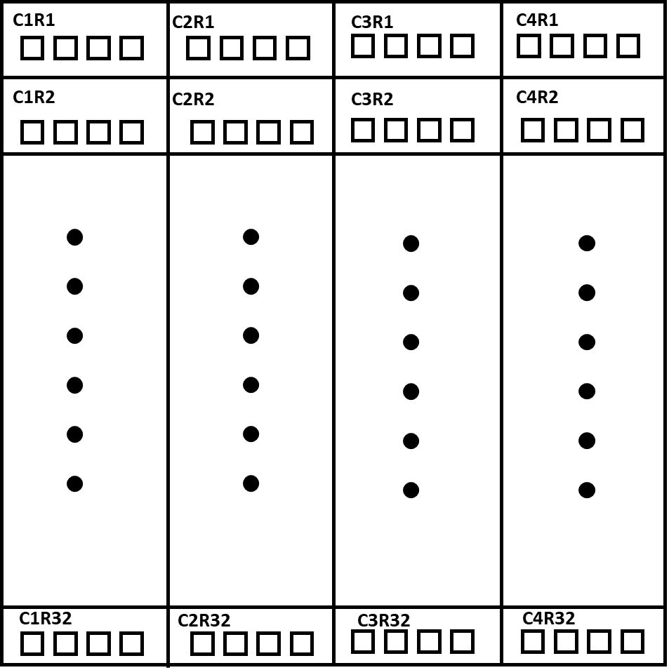
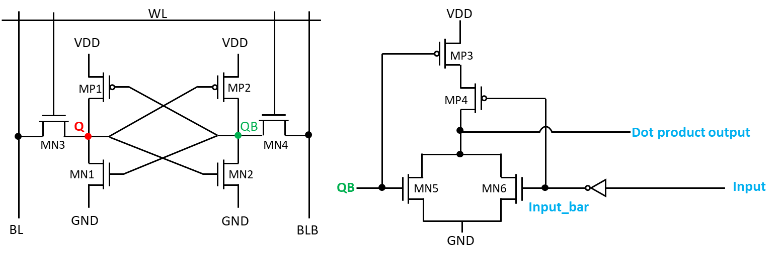
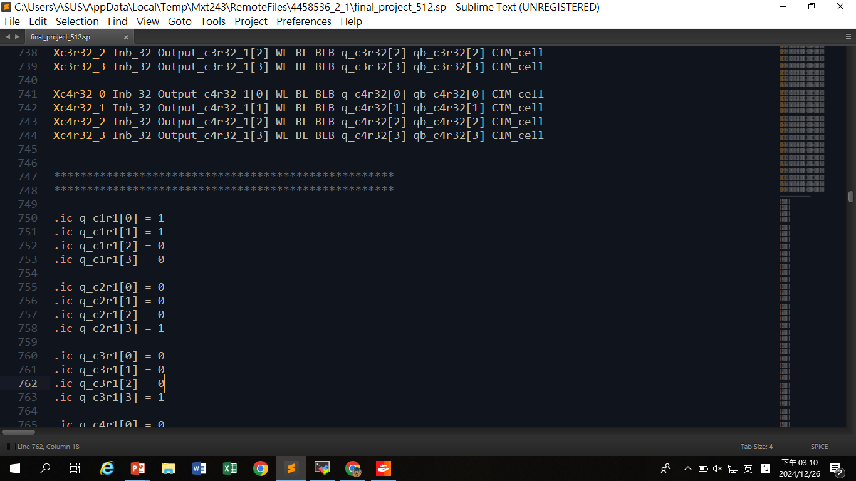
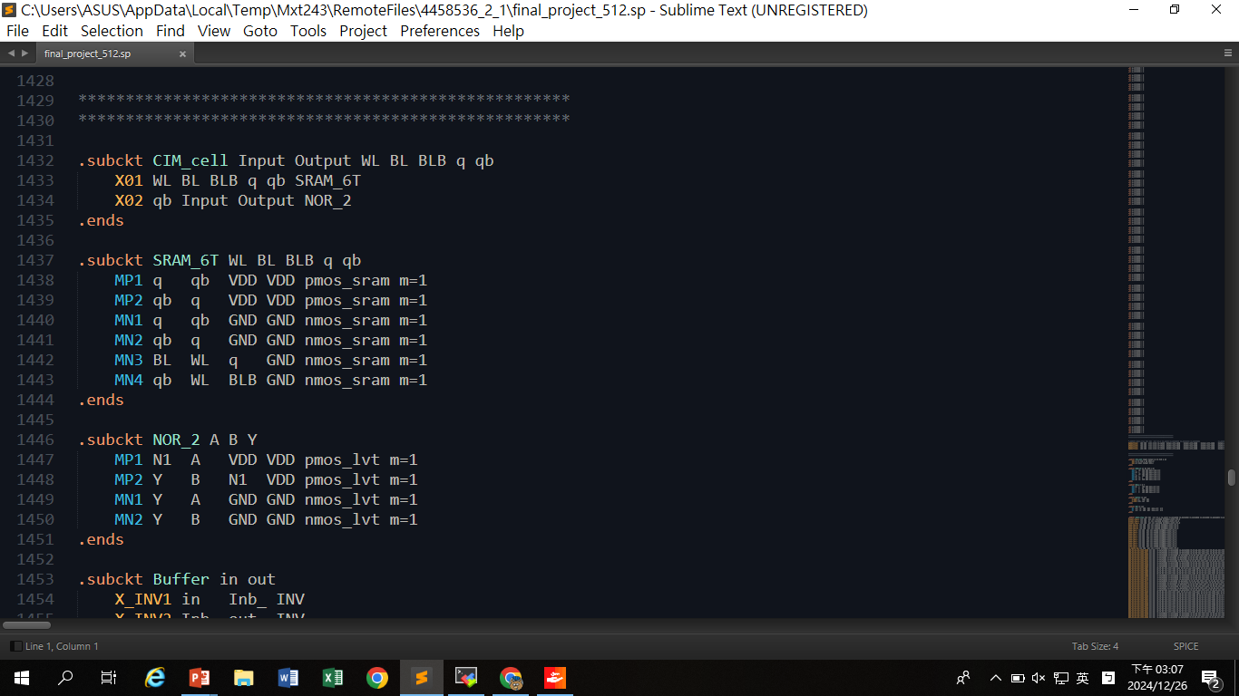
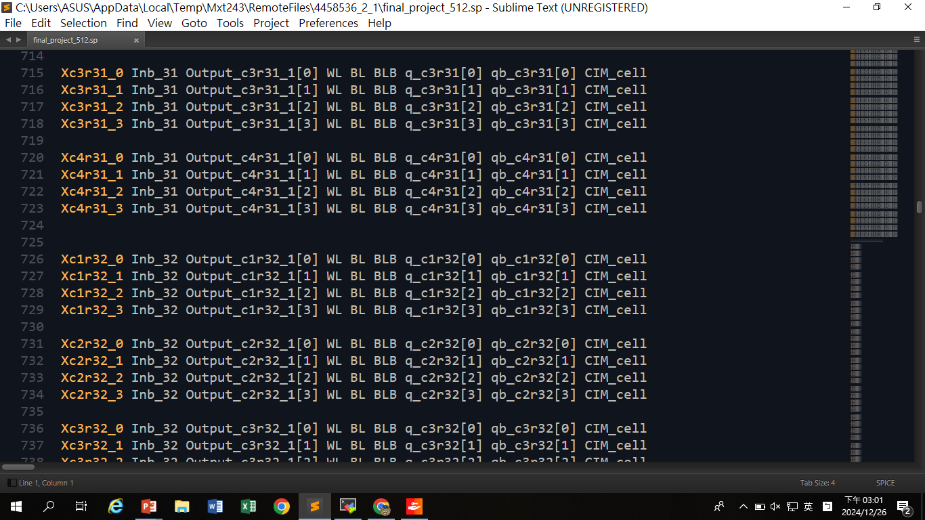
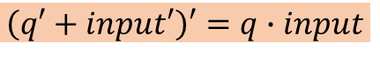
Overview: the dot product matrix
One CIM_cell of the matrix
SRAM
NOR gate
3
2
1
0
Q點用於儲存weight，以.ic的方式預先設定。
同樣也需要512個.ic。
一共有4 columns x 32 rows x 4 bits = 512 bits
所有spice檔中會像這樣呼叫 CIM_cell 512次
助教提供的CIM_cell為6T SRAM及NOR gate組成。
$$\left(q′+input′\right)′=q∙input$$

Slide 5
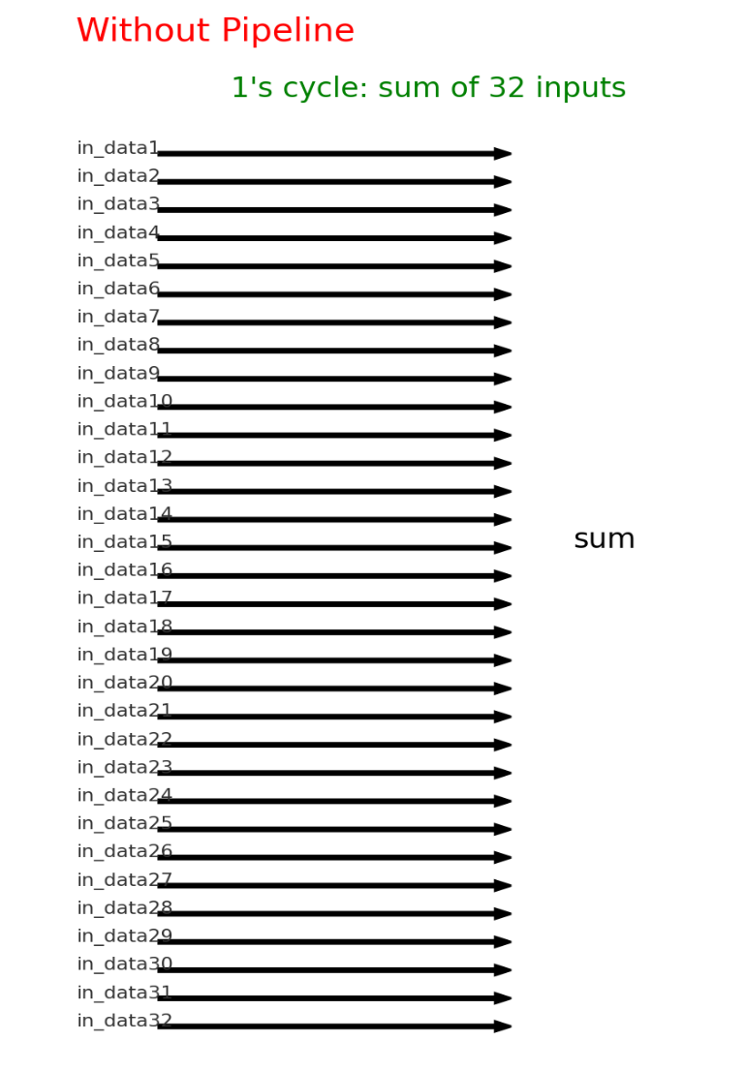
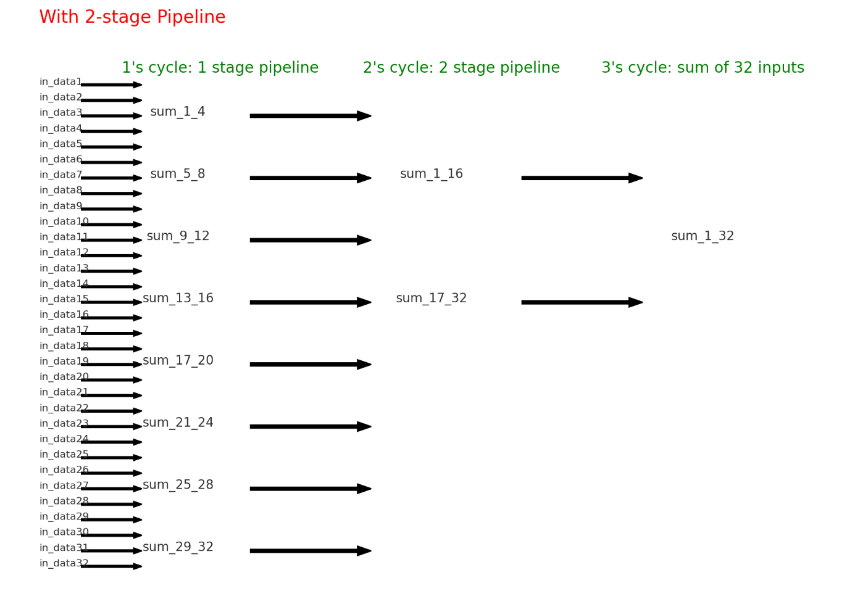
Overview: the Adder-tree
The adder-tree
Ver.1：Original design. (without pipeline)
Ver2.：Use pipeline to achieve 80GOPs

Slide 6
The adder-tree original design
Version 1: without pipeline

Slide 7
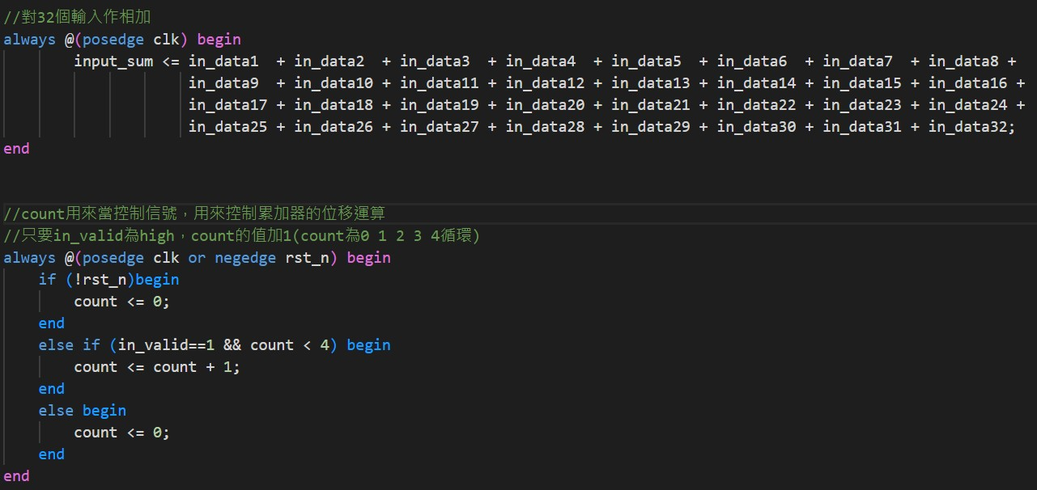
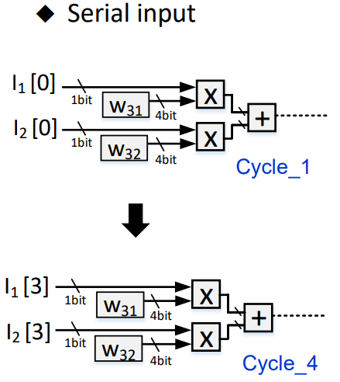
Adder tree ver.1
Original design.
這個方法就是一次把32組input*weight後的值相加，並設一個名為count 的register用來當控制信號，控制累加器的位移運算，只要in_valid為high且count<4，count的值加1(count為0 1 2 3 4循環)

Slide 8
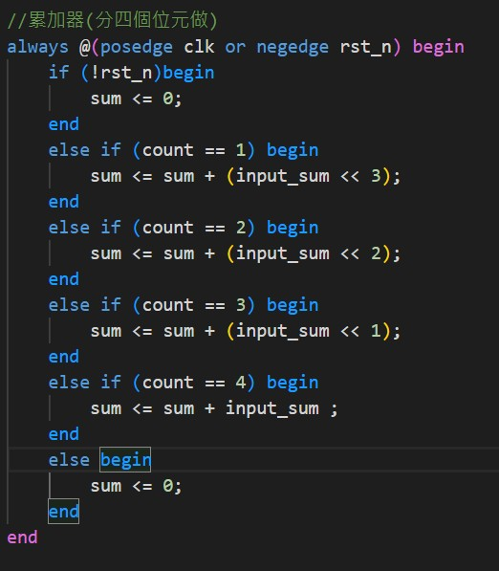
Adder tree ver.1
這邊是累加器:
1.第一個cycle(sum+MSB)，需將MSB左移3位元再做相加
2.第二個cycle(sum+Second MSB)，需將Second MSB左移2位元再做相加
3.第三個cycle(sum+Third MSB)，需將Third MSB左移1位元再做相加
4.第四個cycle(sum+LSB)，LSB無需位移
5.第五個cycle(把sum歸零)

Slide 9
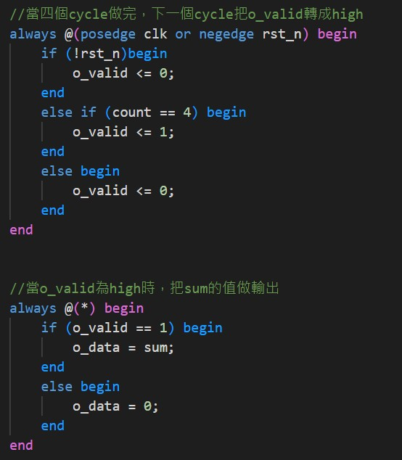
Adder tree ver.1
當4個cycle做完之後，下一個cycle把o_valid轉成high，而當o_valid為high的時候， output data 就會被assign sum的值

Slide 10
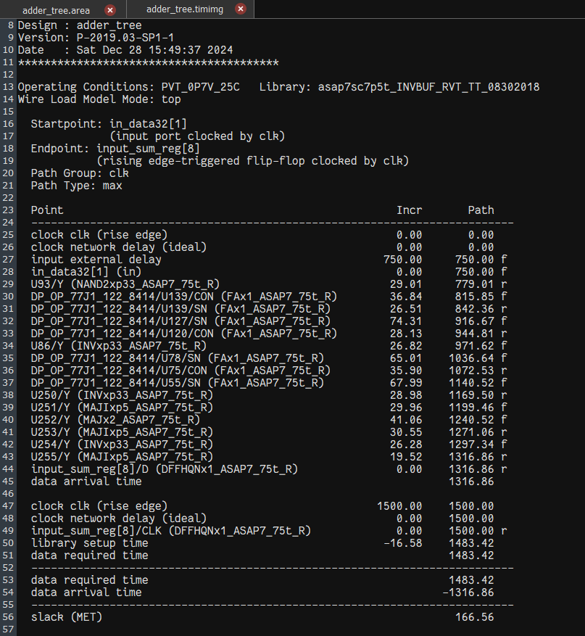
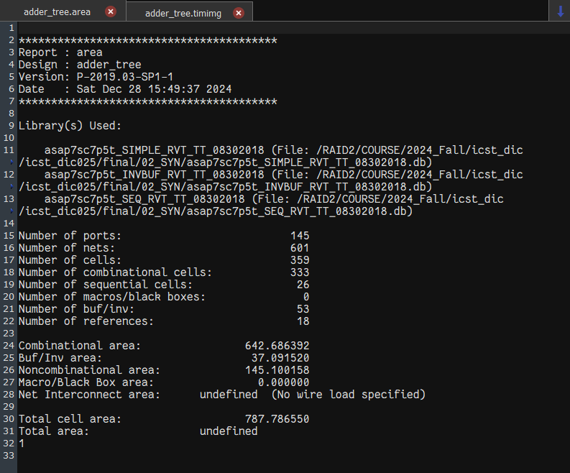
Adder tree ver.1
Clock period = 1.5ns
Delay = 1316.86 ps
Slack = 166.56ps (>0)
Area = 787.78655μm²
timing report.
Area report.

Slide 11
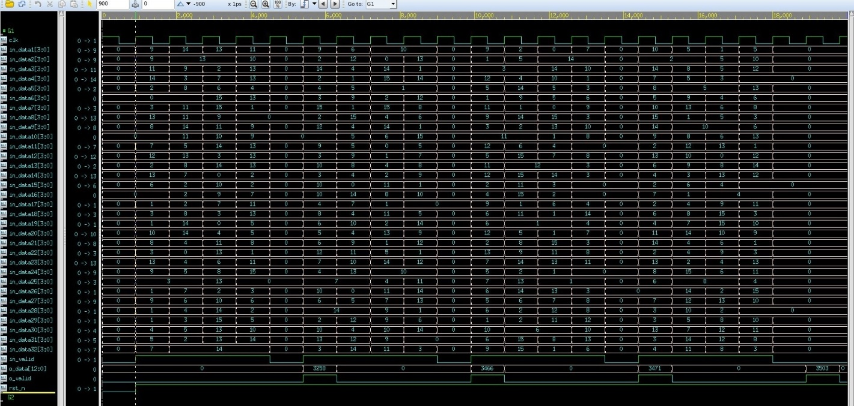
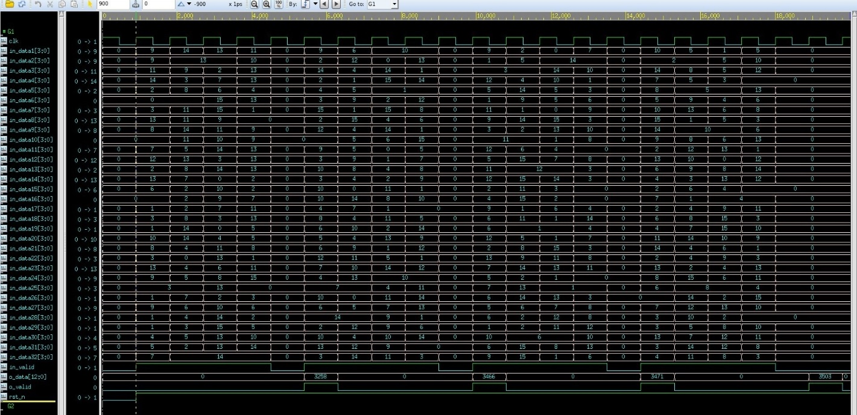
Adder tree ver.1
01_RTL waveforms from nWave.
03_Gate waveforms from nWave.
根據01和03的波形，可以看到兩者皆能輸出正確的計算值，可確認adder tree計算功能正確。
Notes:
那通過gate level 的驗證後，接著看波型如圖，可以看出是算好四筆資料後再一次全部加起來, 功能正確. 有些微 delay，它經過一些 Delay 時間才穩定（十進位）。

Slide 12
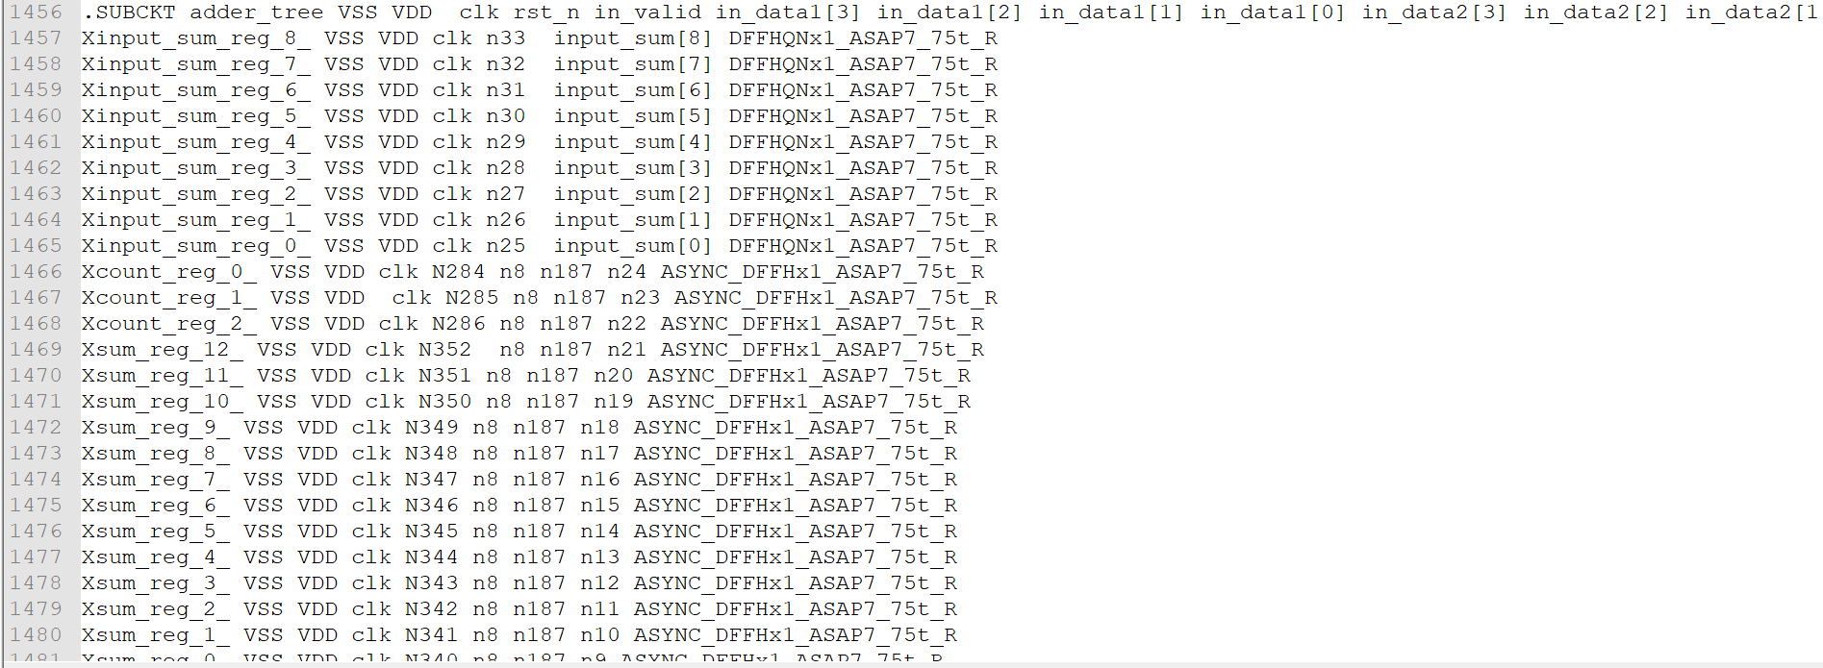
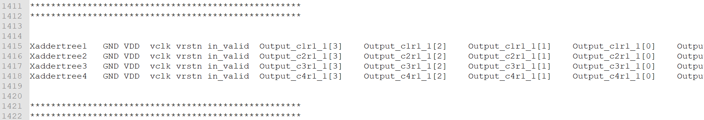
Adder tree ver.1
Netlist of adder tree subcircuit (.sp)
node connections for calls
通過gate level 的驗證並確認波型後，使用verilog2spice將.v轉換為.sp檔，產生出addertree的subckt，並將其於主電路當中進行呼叫，對應的節點連接如圖所示，點乘結果的output會連接至addertree對應的input端口
Notes:
那通過gate level 的驗證後，接著看波型如圖，可以看出是算好四筆資料後再一次全部加起來, 功能正確. 有些微 delay，它經過一些 Delay 時間才穩定（十進位）。

Slide 13
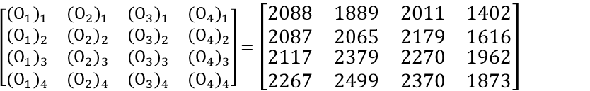
Adder tree ver.1
註記 | cycle |  | time | Input_1 | Input_2 | Input_3 | Input_4 | Input_5 | Input_6 | Input_7 | Input_8 | Input_9 | Input_10 | Input_11 | Input_12 | Input_13 | Input_14 | Input_15 | Input_16 | Input_17 | Input_18 | Input_19 | Input_20 | Input_21 | Input_22 | Input_23 | Input_24 | Input_25 | Input_26 | Input_27 | Input_28 | Input_29 | Input_30 | Input_31 | Input_32
 |  | X | 0 | 0 | 0 | 0 | 0 | 0 | 0 | 0 | 0 | 0 | 0 | 0 | 0 | 0 | 0 | 0 | 0 | 0 | 0 | 0 | 0 | 0 | 0 | 0 | 0 | 0 | 0 | 0 | 0 | 0 | 0 | 0 | 0
第1組 input[0:3] 1cycle 1bit | 1 | input[0] | 1.5 | 0 | 1 | 0 | 1 | 1 | 0 | 0 | 1 | 1 | 0 | 1 | 0 | 1 | 0 | 1 | 1 | 1 | 1 | 0 | 1 | 1 | 1 | 0 | 0 | 1 | 0 | 1 | 0 | 0 | 1 | 0 | 0
 | 2 | input[1] | 3 | 1 | 1 | 0 | 0 | 1 | 0 | 1 | 0 | 1 | 0 | 1 | 0 | 1 | 1 | 1 | 1 | 0 | 0 | 0 | 1 | 1 | 1 | 0 | 1 | 0 | 1 | 0 | 0 | 1 | 1 | 0 | 1
 | 3 | input[2] | 4.5 | 0 | 0 | 1 | 1 | 0 | 1 | 1 | 1 | 0 | 1 | 1 | 0 | 0 | 1 | 0 | 0 | 1 | 0 | 1 | 0 | 1 | 0 | 1 | 1 | 0 | 1 | 0 | 0 | 0 | 1 | 1 | 0
 | 4 | input[3] | 6 | 1 | 1 | 0 | 1 | 1 | 0 | 1 | 1 | 1 | 1 | 1 | 1 | 0 | 1 | 1 | 0 | 1 | 0 | 0 | 1 | 1 | 1 | 1 | 0 | 0 | 0 | 0 | 1 | 1 | 0 | 1 | 1
 | 5 | X | 7.5 | 1 | 1 | 0 | 1 | 1 | 0 | 1 | 1 | 1 | 1 | 1 | 1 | 0 | 1 | 1 | 0 | 1 | 0 | 0 | 1 | 1 | 1 | 1 | 0 | 0 | 0 | 0 | 1 | 1 | 0 | 1 | 1
第2組 input[0:3] 1cycle 1bit | 6 | input[0] | 9 | 0 | 1 | 0 | 1 | 1 | 0 | 0 | 1 | 1 | 0 | 1 | 0 | 1 | 0 | 1 | 1 | 1 | 1 | 0 | 1 | 1 | 1 | 0 | 0 | 1 | 0 | 1 | 0 | 0 | 1 | 0 | 0
 | 7 | input[1] | 10.5 | 1 | 1 | 0 | 0 | 0 | 1 | 1 | 1 | 1 | 1 | 1 | 1 | 0 | 1 | 1 | 1 | 1 | 0 | 1 | 0 | 0 | 1 | 0 | 1 | 1 | 1 | 0 | 1 | 1 | 0 | 0 | 1
 | 8 | input[2] | 12 | 1 | 0 | 1 | 1 | 0 | 0 | 1 | 1 | 1 | 1 | 0 | 1 | 1 | 0 | 1 | 1 | 0 | 1 | 0 | 0 | 1 | 0 | 1 | 1 | 1 | 0 | 0 | 1 | 1 | 1 | 1 | 0
 | 9 | input[3] | 13.5 | 0 | 1 | 0 | 0 | 0 | 1 | 1 | 1 | 1 | 0 | 1 | 1 | 1 | 1 | 1 | 1 | 1 | 0 | 1 | 0 | 1 | 0 | 1 | 1 | 0 | 0 | 0 | 0 | 1 | 1 | 1 | 0
 | 10 | X | 15 | 0 | 1 | 0 | 0 | 0 | 1 | 1 | 1 | 1 | 0 | 1 | 1 | 1 | 1 | 1 | 1 | 1 | 0 | 1 | 0 | 1 | 0 | 1 | 1 | 0 | 0 | 0 | 0 | 1 | 1 | 1 | 0
第3組 input[0:3] 1cycle 1bit | 11 | input[0] | 16.5 | 1 | 1 | 0 | 1 | 0 | 1 | 1 | 0 | 0 | 1 | 0 | 1 | 1 | 1 | 0 | 0 | 0 | 1 | 1 | 0 | 0 | 1 | 1 | 1 | 0 | 1 | 1 | 0 | 1 | 1 | 0 | 0
 | 12 | input[1] | 18 | 0 | 1 | 1 | 1 | 1 | 0 | 1 | 0 | 0 | 1 | 0 | 0 | 1 | 1 | 1 | 1 | 0 | 1 | 1 | 1 | 0 | 0 | 1 | 1 | 1 | 1 | 1 | 1 | 0 | 0 | 0 | 1
 | 13 | input[2] | 19.5 | 1 | 1 | 1 | 1 | 0 | 1 | 0 | 1 | 1 | 1 | 1 | 0 | 0 | 1 | 1 | 1 | 0 | 1 | 0 | 1 | 1 | 1 | 0 | 0 | 0 | 1 | 1 | 1 | 0 | 1 | 1 | 0
 | 14 | input[3] | 21 | 1 | 0 | 1 | 0 | 1 | 0 | 0 | 1 | 1 | 1 | 1 | 0 | 0 | 1 | 1 | 1 | 1 | 0 | 0 | 1 | 1 | 0 | 0 | 0 | 1 | 1 | 1 | 0 | 1 | 0 | 0 | 1
 | 15 | X | 22.5 | 1 | 0 | 1 | 0 | 1 | 0 | 0 | 1 | 1 | 1 | 1 | 0 | 0 | 1 | 1 | 1 | 1 | 0 | 0 | 1 | 1 | 0 | 0 | 0 | 1 | 1 | 1 | 0 | 1 | 0 | 0 | 1
第4組 input[0:3] 1cycle 1bit | 16 | input[0] | 24 | 1 | 0 | 1 | 0 | 1 | 1 | 0 | 0 | 0 | 1 | 0 | 1 | 1 | 0 | 1 | 1 | 0 | 1 | 1 | 1 | 0 | 1 | 1 | 1 | 0 | 1 | 1 | 0 | 1 | 0 | 1 | 1
 | 17 | input[1] | 25.5 | 0 | 1 | 1 | 0 | 1 | 1 | 0 | 0 | 0 | 1 | 1 | 0 | 0 | 1 | 1 | 1 | 1 | 0 | 0 | 0 | 0 | 1 | 1 | 1 | 1 | 0 | 1 | 1 | 1 | 0 | 1 | 0
 | 18 | input[2] | 27 | 0 | 0 | 1 | 0 | 1 | 0 | 1 | 1 | 0 | 0 | 0 | 1 | 1 | 1 | 0 | 1 | 0 | 1 | 0 | 1 | 1 | 1 | 0 | 1 | 0 | 1 | 0 | 1 | 1 | 1 | 0 | 0
 | 19 | input[3] | 28.5 | 1 | 1 | 1 | 1 | 0 | 1 | 1 | 0 | 1 | 1 | 0 | 0 | 1 | 0 | 0 | 1 | 1 | 0 | 1 | 1 | 1 | 0 | 1 | 1 | 0 | 0 | 1 | 1 | 0 | 1 | 1 | 1
 | 20 | X | 30 | 1 | 1 | 1 | 1 | 0 | 1 | 1 | 0 | 1 | 1 | 0 | 0 | 1 | 0 | 0 | 1 | 1 | 0 | 1 | 1 | 1 | 0 | 1 | 1 | 0 | 0 | 1 | 1 | 0 | 1 | 1 | 1
Input pattern
 | row | [1] | [2] | [3] | [4] | [5] | [6] | [7] | [8] | [9] | [10] | [11] | [12] | [13] | [14] | [15] | [16] | [17] | [18] | [19] | [20] | [21] | [22] | [23] | [24] | [25] | [26] | [27] | [28] | [29] | [30] | [31] | [32]
Column 1 | W1[3] | 0 | 1 | 1 | 1 | 1 | 0 | 1 | 0 | 0 | 0 | 1 | 1 | 1 | 1 | 0 | 1 | 1 | 0 | 0 | 1 | 0 | 1 | 1 | 0 | 0 | 1 | 0 | 1 | 1 | 0 | 1 | 1
 | W1[2] | 0 | 1 | 0 | 0 | 1 | 0 | 0 | 0 | 1 | 1 | 0 | 1 | 0 | 0 | 0 | 0 | 1 | 1 | 0 | 1 | 1 | 0 | 0 | 1 | 0 | 0 | 0 | 0 | 0 | 1 | 0 | 1
 | W1[1] | 1 | 0 | 0 | 0 | 1 | 0 | 1 | 1 | 1 | 0 | 0 | 1 | 1 | 0 | 0 | 0 | 0 | 1 | 1 | 1 | 1 | 1 | 1 | 0 | 1 | 0 | 0 | 0 | 1 | 0 | 0 | 1
 | W1[0] | 1 | 1 | 1 | 0 | 1 | 1 | 0 | 0 | 1 | 0 | 0 | 0 | 1 | 1 | 1 | 0 | 1 | 1 | 1 | 1 | 0 | 0 | 1 | 0 | 1 | 1 | 0 | 0 | 0 | 0 | 0 | 1
 | weight 1 [1:32] | 3 | 13 | 9 | 8 | 15 | 1 | 10 | 2 | 7 | 4 | 8 | 14 | 11 | 9 | 1 | 8 | 13 | 7 | 3 | 15 | 6 | 10 | 11 | 4 | 3 | 9 | 0 | 8 | 10 | 4 | 8 | 15
Column 2 | W2[3] | 1 | 1 | 1 | 0 | 0 | 1 | 1 | 0 | 0 | 1 | 0 | 1 | 1 | 0 | 0 | 1 | 0 | 1 | 1 | 0 | 1 | 1 | 1 | 1 | 0 | 0 | 1 | 0 | 1 | 0 | 1 | 1
 | W2[2] | 0 | 0 | 0 | 1 | 1 | 1 | 0 | 0 | 1 | 0 | 0 | 1 | 1 | 1 | 0 | 1 | 1 | 0 | 0 | 0 | 0 | 1 | 1 | 0 | 0 | 1 | 0 | 0 | 0 | 1 | 0 | 1
 | W2[1] | 1 | 0 | 0 | 1 | 1 | 0 | 0 | 1 | 0 | 0 | 0 | 1 | 0 | 0 | 1 | 1 | 1 | 0 | 1 | 0 | 0 | 1 | 0 | 0 | 1 | 0 | 1 | 0 | 0 | 1 | 0 | 1
 | W2[0] | 0 | 1 | 0 | 1 | 0 | 0 | 0 | 1 | 0 | 0 | 1 | 1 | 1 | 1 | 0 | 1 | 1 | 0 | 0 | 0 | 1 | 1 | 0 | 0 | 1 | 1 | 1 | 0 | 0 | 0 | 0 | 0
 | weight 2[1:32] | 10 | 9 | 8 | 7 | 6 | 12 | 8 | 3 | 4 | 8 | 1 | 15 | 13 | 5 | 2 | 15 | 7 | 8 | 10 | 0 | 9 | 15 | 12 | 8 | 3 | 5 | 11 | 0 | 8 | 6 | 8 | 14
Column 3 | W3[3] | 1 | 0 | 1 | 1 | 1 | 0 | 1 | 0 | 1 | 1 | 0 | 1 | 1 | 0 | 1 | 1 | 1 | 1 | 1 | 0 | 0 | 1 | 0 | 1 | 1 | 1 | 1 | 0 | 1 | 1 | 1 | 1
 | W3[2] | 0 | 0 | 1 | 1 | 0 | 1 | 1 | 1 | 1 | 0 | 1 | 0 | 0 | 0 | 0 | 1 | 0 | 0 | 0 | 1 | 0 | 0 | 0 | 0 | 0 | 1 | 0 | 0 | 0 | 0 | 1 | 0
 | W3[1] | 0 | 0 | 1 | 0 | 0 | 0 | 1 | 0 | 1 | 1 | 1 | 0 | 0 | 0 | 0 | 0 | 0 | 0 | 0 | 0 | 0 | 0 | 1 | 0 | 0 | 0 | 1 | 0 | 0 | 0 | 0 | 1
 | W3[0] | 1 | 0 | 1 | 1 | 0 | 0 | 1 | 0 | 0 | 0 | 1 | 0 | 1 | 0 | 0 | 0 | 0 | 0 | 1 | 0 | 0 | 0 | 0 | 0 | 0 | 1 | 0 | 1 | 1 | 0 | 0 | 1
 | weight 3[1:32] | 9 | 0 | 15 | 13 | 8 | 4 | 15 | 4 | 14 | 10 | 7 | 8 | 9 | 0 | 8 | 12 | 8 | 8 | 9 | 4 | 0 | 8 | 2 | 8 | 8 | 13 | 10 | 1 | 9 | 8 | 12 | 11
Column 4 | W4[3] | 0 | 0 | 1 | 1 | 0 | 1 | 1 | 0 | 0 | 1 | 0 | 0 | 0 | 0 | 0 | 0 | 0 | 1 | 1 | 0 | 0 | 1 | 1 | 1 | 1 | 0 | 0 | 0 | 1 | 1 | 0 | 1
 | W4[2] | 0 | 1 | 0 | 0 | 0 | 0 | 0 | 0 | 1 | 1 | 0 | 0 | 1 | 0 | 0 | 1 | 0 | 1 | 1 | 0 | 0 | 0 | 0 | 0 | 0 | 0 | 1 | 1 | 0 | 1 | 1 | 0
 | W4[1] | 1 | 0 | 1 | 0 | 1 | 0 | 0 | 1 | 0 | 1 | 0 | 1 | 0 | 0 | 1 | 1 | 1 | 0 | 1 | 1 | 0 | 0 | 0 | 0 | 0 | 0 | 0 | 1 | 0 | 1 | 0 | 0
 | W4[0] | 0 | 1 | 0 | 0 | 0 | 0 | 1 | 1 | 1 | 1 | 0 | 1 | 1 | 1 | 1 | 0 | 0 | 0 | 1 | 1 | 0 | 1 | 0 | 1 | 0 | 0 | 0 | 1 | 0 | 1 | 1 | 0
 | weight 4[1:32] | 2 | 5 | 10 | 8 | 2 | 8 | 9 | 3 | 5 | 15 | 0 | 3 | 5 | 1 | 3 | 6 | 2 | 12 | 15 | 3 | 0 | 9 | 8 | 9 | 8 | 0 | 4 | 7 | 8 | 15 | 5 | 8
weight pattern
根據公式並代入我們的input、weight pattern，可計算出預計輸出結果(Decimal)如下
$${\left(O_{1}\right)}_{1}=\left({\left(I_{1}\right)}_{1}×{\left(W_{1}\right)}_{1}\right)+\left({\left(I_{2}\right)}_{1}×{\left(W_{1}\right)}_{1}\right)+⋯\left({\left(I_{32}\right)}_{1}×{\left(W_{1}\right)}_{32}\right)$$
$\left[\begin{matrix}\begin{matrix}{(O_{1})}_{1} & {(O_{2})}_{1} \\ {(O_{1})}_{2} & {(O_{2})}_{2}\end{matrix} & \begin{matrix}{(O_{3})}_{1} & {(O_{4})}_{1} \\ {(O_{3})}_{2} & {(O_{4})}_{2}\end{matrix} \\ \begin{matrix}{(O_{1})}_{3} & {(O_{2})}_{3} \\ {(O_{1})}_{4} & {(O_{2})}_{4}\end{matrix} & \begin{matrix}{(O_{3})}_{3} & {(O_{4})}_{3} \\ {(O_{3})}_{4} & {(O_{4})}_{4}\end{matrix}\end{matrix}\right]$ = $\left[\begin{matrix}\begin{matrix}2088 & 1889 \\ 2087 & 2065\end{matrix} & \begin{matrix}2011 & 1402 \\ 2179 & 1616\end{matrix} \\ \begin{matrix}2117 & 2379 \\ 2267 & 2499\end{matrix} & \begin{matrix}2270 & 1962 \\ 2370 & 1873\end{matrix}\end{matrix}\right]$
$${\left(O_{2}\right)}_{1}=\left({\left(I_{1}\right)}_{1}×{\left(W_{2}\right)}_{1}\right)+\left({\left(I_{2}\right)}_{1}×{\left(W_{2}\right)}_{2}\right)+⋯\left({\left(I_{32}\right)}_{1}×{\left(W_{2}\right)}_{32}\right)$$
$${\left(O_{1}\right)}_{2}=\left({\left(I_{1}\right)}_{2}×{\left(W_{1}\right)}_{1}\right)+\left({\left(I_{2}\right)}_{2}×{\left(W_{1}\right)}_{2}\right)+⋯\left({\left(I_{32}\right)}_{2}×{\left(W_{1}\right)}_{32}\right)$$
Notes:
那通過gate level 的驗證後，接著看波型如圖，可以看出是算好四筆資料後再一次全部加起來, 功能正確. 有些微 delay，它經過一些 Delay 時間才穩定（十進位）。

Slide 14
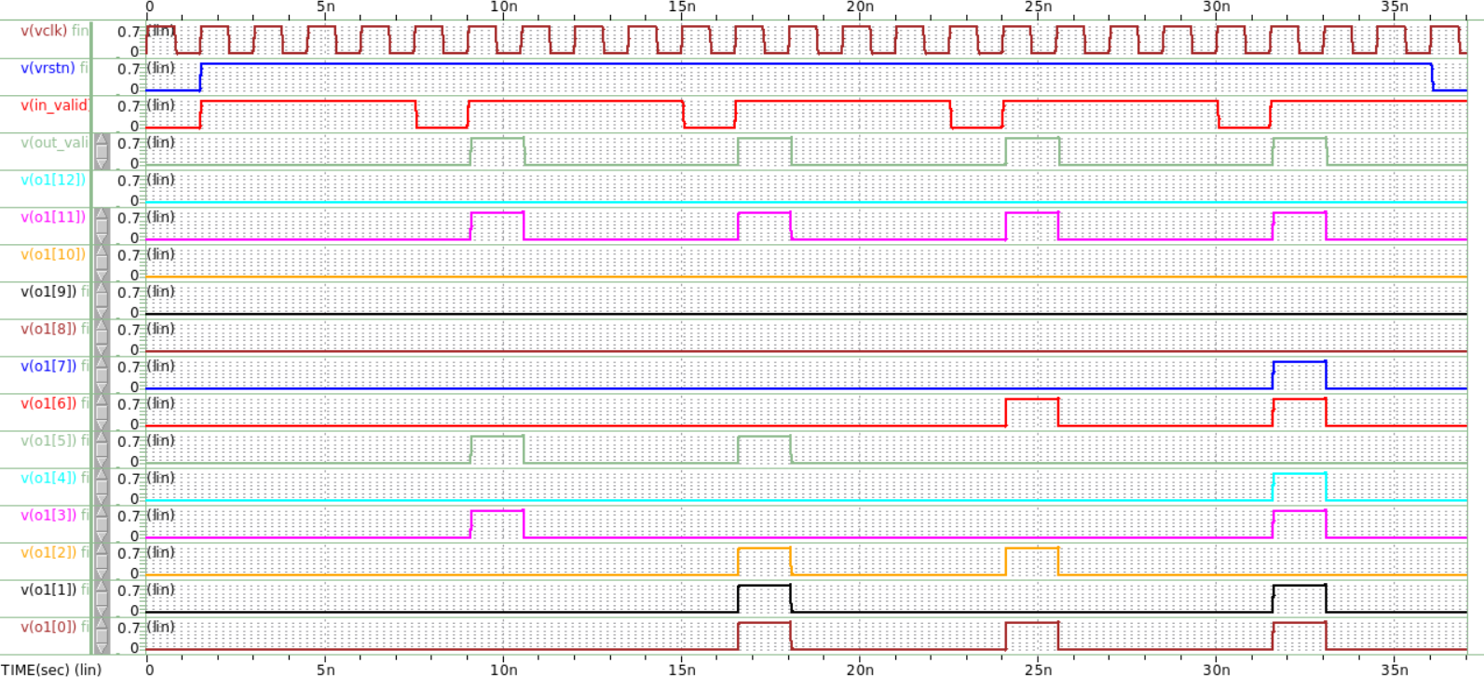
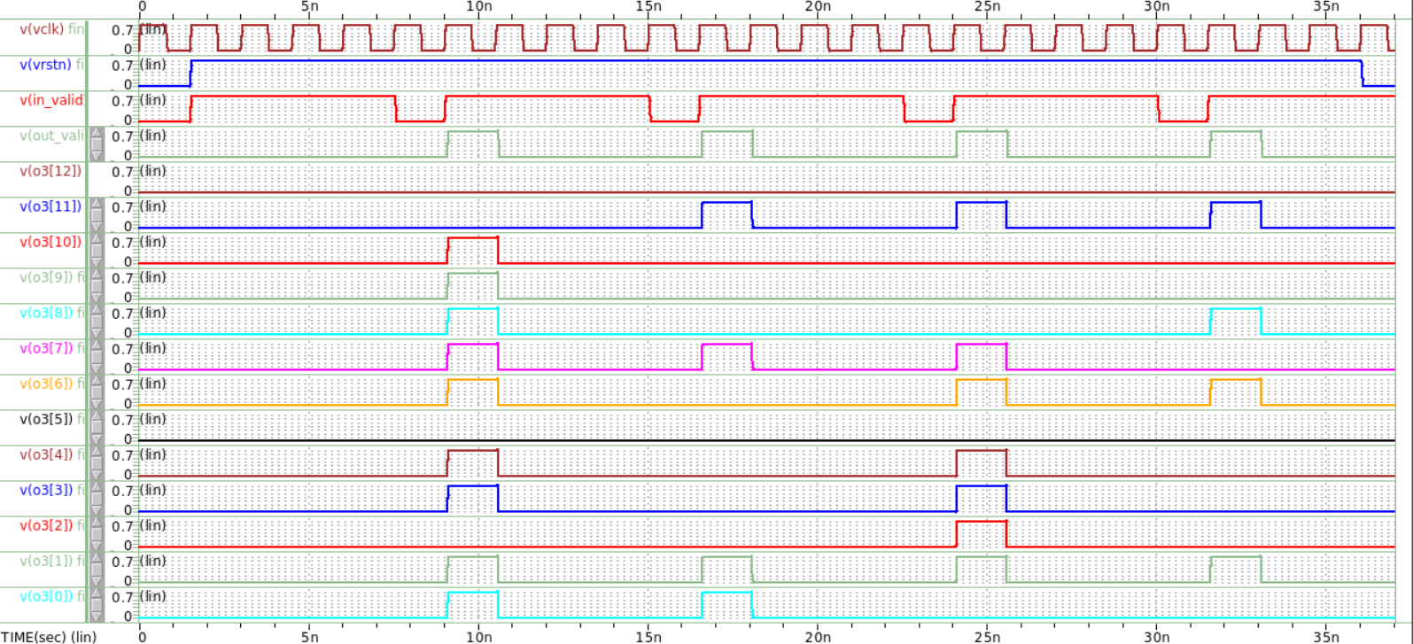
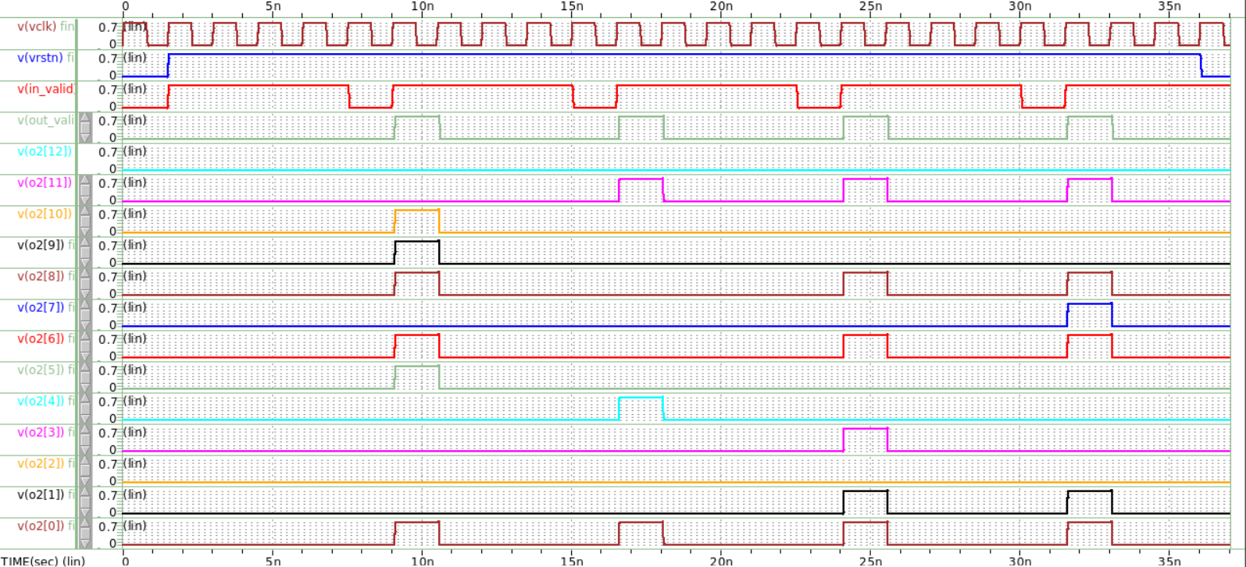
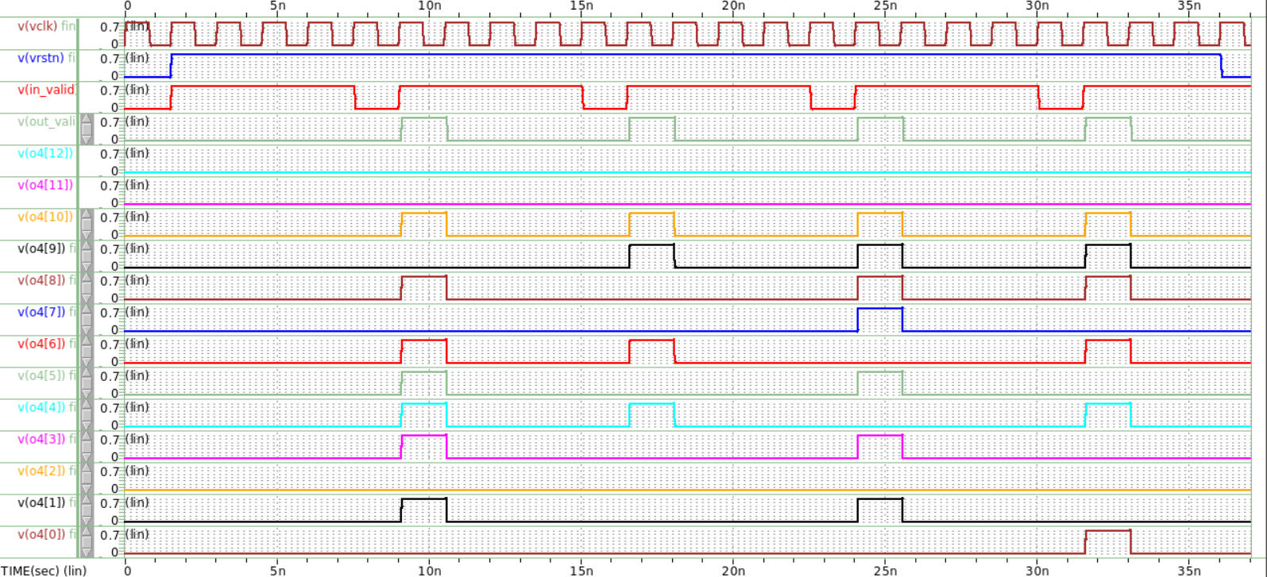
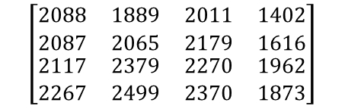
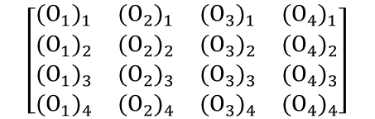
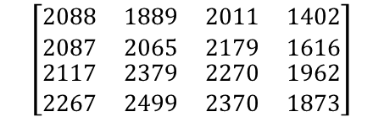
Adder tree ver.1
$$\left[\begin{matrix}\begin{matrix}{(O_{1})}_{1} & {(O_{2})}_{1} \\ {(O_{1})}_{2} & {(O_{2})}_{2}\end{matrix} & \begin{matrix}{(O_{3})}_{1} & {(O_{4})}_{1} \\ {(O_{3})}_{2} & {(O_{4})}_{2}\end{matrix} \\ \begin{matrix}{(O_{1})}_{3} & {(O_{2})}_{3} \\ {(O_{1})}_{4} & {(O_{2})}_{4}\end{matrix} & \begin{matrix}{(O_{3})}_{3} & {(O_{4})}_{3} \\ {(O_{3})}_{4} & {(O_{4})}_{4}\end{matrix}\end{matrix}\right]$$
0
0
0
0
0
0
0
0
1
1
1
1
0
1
1
1
0
0
0
0
1
0
0
0
0
0
0
0
1
0
0
0
0
0
0
0
1
0
0
1
輸出理論值
0
0
0
1
1
1
1
0
0
0
1
1
1
0
1
1
1
1
0
0
0
0
0
0
$$\left[\begin{matrix}\begin{matrix}2088 & 1889 \\ 2087 & 2065\end{matrix} & \begin{matrix}2011 & 1402 \\ 2179 & 1616\end{matrix} \\ \begin{matrix}2117 & 2379 \\ 2267 & 2499\end{matrix} & \begin{matrix}2270 & 1962 \\ 2370 & 1873\end{matrix}\end{matrix}\right]$$
0
0
0
1
1
0
1
0
1
0
0
1
1
0
1
0
0
1
1
0
0
0
1
0
0
1
0
1
1
1
1
1
0
1
1
1
1
1
0
0
(O1)₁=2088
(O1)₂=2087
(O1)₃=2117
(O1)₄=2267
(O3)₁=2011
(O3)₂=2179
(O3)₃=2270
(O3)₄=2370
O1 waveforms from Waveview.
O3 waveforms from Waveview.
系統輸出值
$$\left[\begin{matrix}\begin{matrix}2088 & 1889 \\ 2087 & 2065\end{matrix} & \begin{matrix}2011 & 1402 \\ 2179 & 1616\end{matrix} \\ \begin{matrix}2117 & 2379 \\ 2267 & 2499\end{matrix} & \begin{matrix}2270 & 1962 \\ 2370 & 1873\end{matrix}\end{matrix}\right]$$
0
0
0
0
0
0
0
0
0
1
1
1
0
0
0
0
1
0
0
0
1
1
1
1
1
0
0
0
0
1
1
1
1
0
1
1
1
0
1
1
由HSPICE模擬結果可見系統計算結果與理論計算值一致，本系統function正確。
0
0
0
1
0
0
1
0
1
0
1
1
1
1
0
1
1
0
0
0
1
0
1
0
0
1
0
0
1
1
0
1
0
0
1
0
1
0
1
0
0
0
0
0
0
0
0
0
0
0
1
1
1
0
1
0
1
1
1
1
0
0
0
1
(O2)₁=1889
(O2)₂=2065
(O2)₃=2379
(O2)₄=2499
(O4)₁=1402
(O4)₂=1616
(O4)₃=1962
(O4)₄=1873
O2 waveforms from Waveview.
O4 waveforms from Waveview.
Notes:
那通過gate level 的驗證後，接著看波型如圖，可以看出是算好四筆資料後再一次全部加起來, 功能正確. 有些微 delay，它經過一些 Delay 時間才穩定（十進位）。

Slide 15
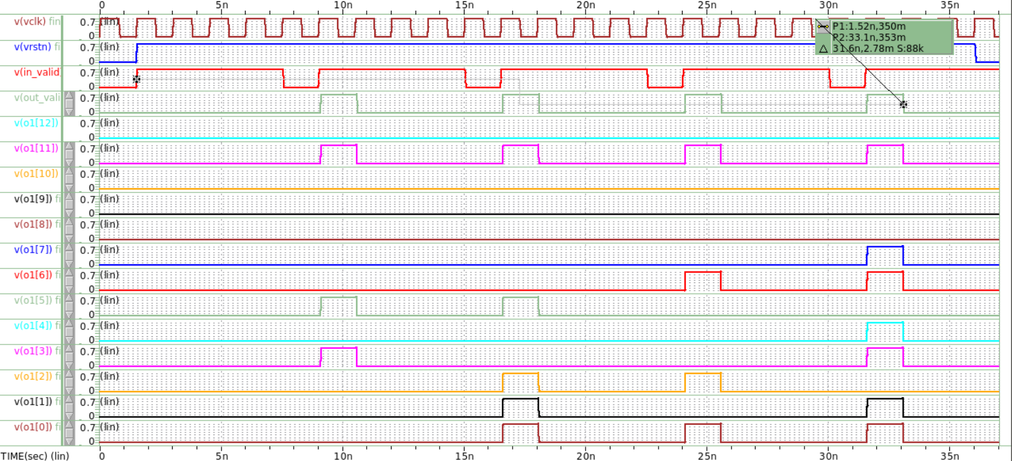
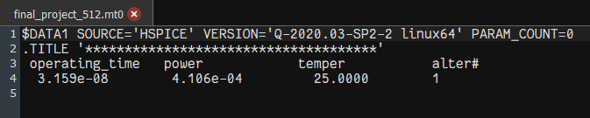



Adder tree ver.1
Operating time = $31.59×{10}^{−9}$ s
Results & Analysis
Using formula provided by TA in EX3,
Throughput (GOPS) =(Operations/operating time)
Operations: (number of multipliers during the operating time) x 2
Operating time: from positive edge of in_valid to negative edge of out_valid
Throughput (GOPS) of Serial Input_V1 ：
$$\frac{Operation}{operating time}=\frac{32×16×2}{31.59×{10}^{−9}}≈32.415 (GOPS)$$
Total power = $4.106×{10}^{−4}$ w
Energy efficiency (TOPS/Watt) of Serial Input_V1 ：
$$\frac{GOPS×{10}^{−3}}{Power}=\frac{32.415×{10}^{−3}}{4.106×{10}^{−4}}≈78.945(TOPS/W)$$
Operating time: 量測in_valid第1個rising edge到out_valid第4個falling edge所經時間
Total power:量測完整輸出一整組output signal的平均功率

Slide 16
The Optimization 1
Version 2: 2 stage pipeline

Slide 17
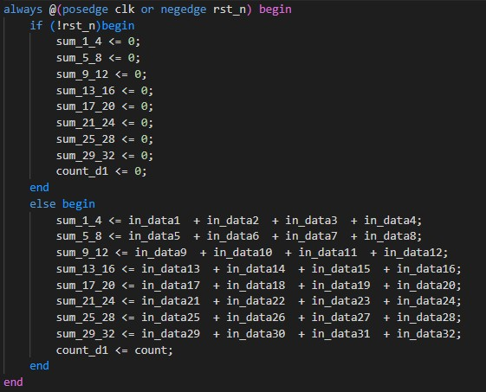
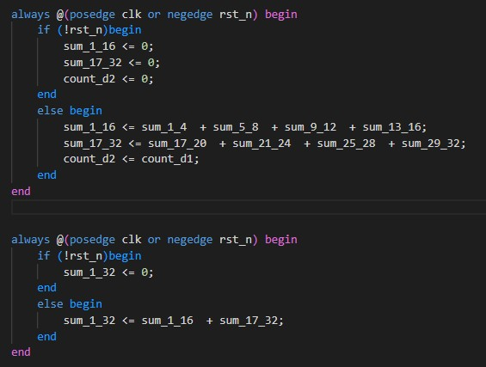
Adder tree ver.2
先將傳入的32個input分成4個4個做相加，並另外設register count_d1，將其更新為count，再將加完的那8個register 4個4個分別加起來放到sum_1_16和sum_17_32，並另外設register count_d2，將其更新為count_d1。
最後再將sum_1_16和sum_17_32加起來即可得input1~input32的加總。

Slide 18
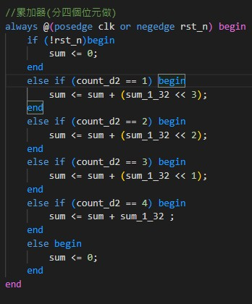
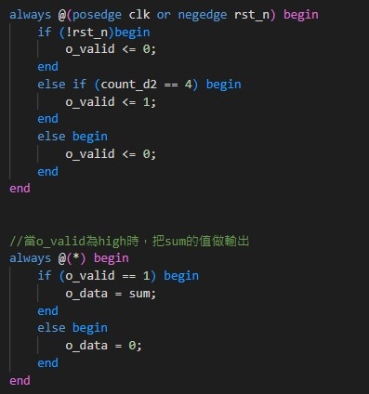
Adder tree ver.2
累加器的架構與version1相同，只是改以count_d2的數值做變化，依序將4個cycle的input值分別shift後，放入sum register
做完之後，下一個cycle把o_valid轉成high，而當o_valid為high的時候， output data 就會被assign sum的值

Slide 19
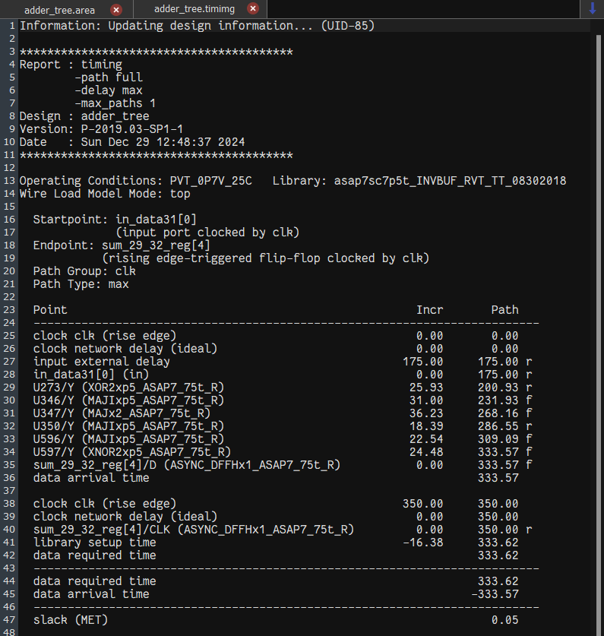
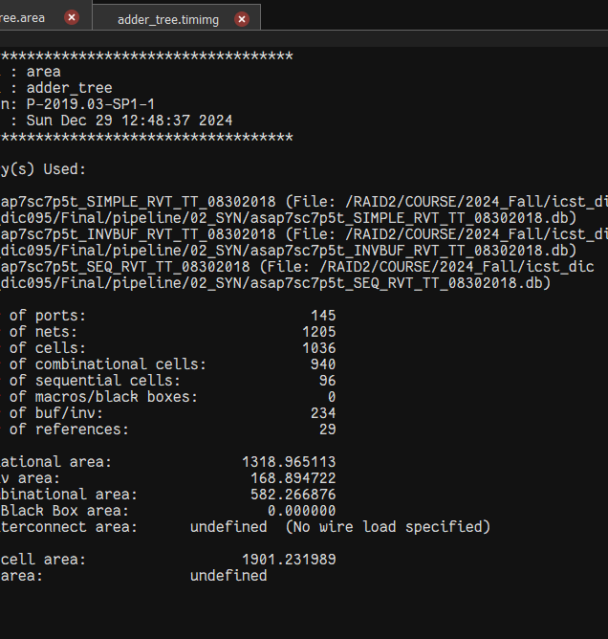
Adder tree ver.2
Clock period = 0.35ns
Delay = 333.57 ps
Slack = 0.05ps (>0)
Area = 1901.231989μm²
timing report.
Area report.

Slide 20
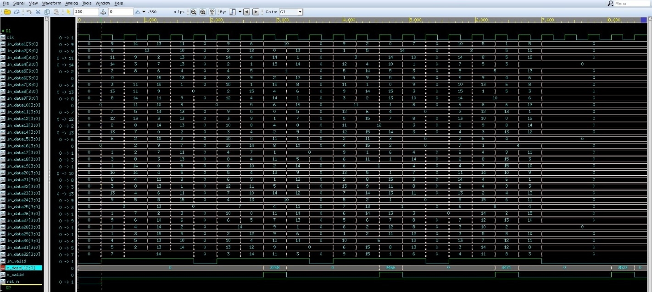
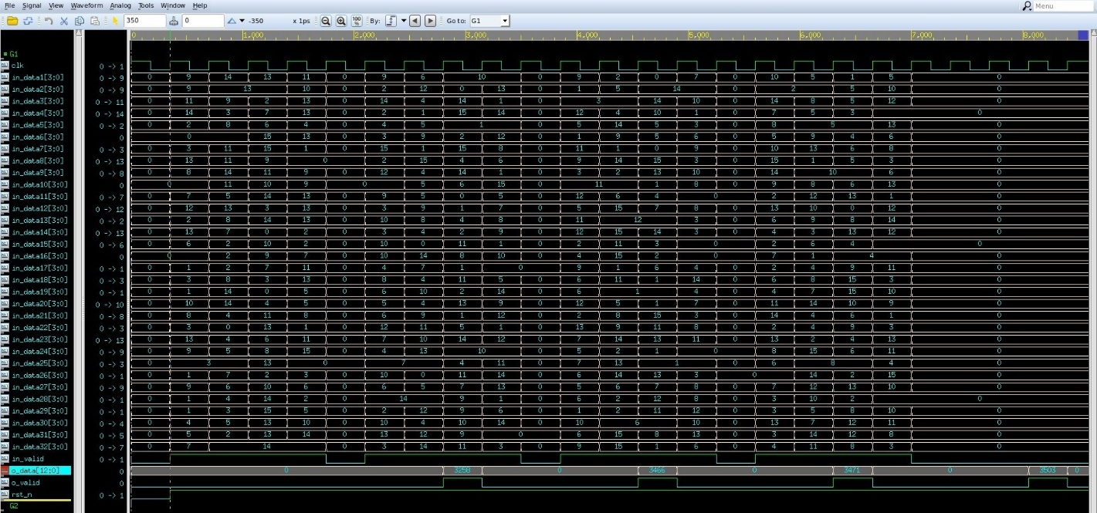
Adder tree ver.2
01_RTL waveforms from nWave.
03_Gate waveforms from nWave.
根據01和03的波形，可以看到兩者皆能輸出正確的計算值，可確認adder tree計算功能正確。
Notes:
那通過gate level 的驗證後，接著看波型如圖，可以看出是算好四筆資料後再一次全部加起來, 功能正確. 有些微 delay，它經過一些 Delay 時間才穩定（十進位）。

Slide 21
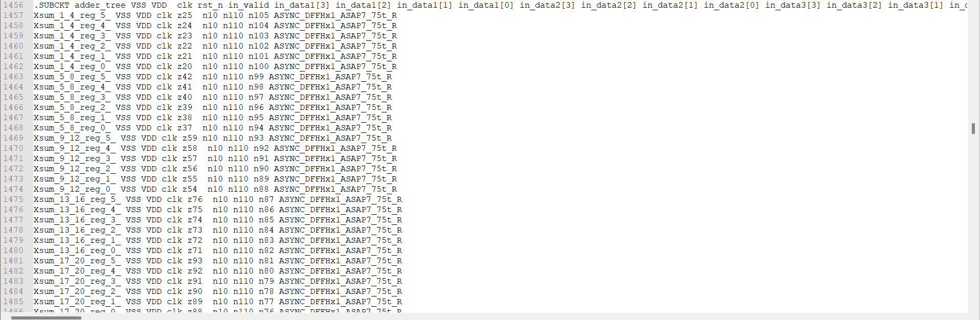
Adder tree ver.2
Netlist of adder tree subcircuit (.sp)
node connections for calls
通過gate level 的驗證並確認波型後，使用verilog2spice將.v轉換為.sp檔，產生出addertree的subckt，並將其於主電路當中進行呼叫，對應的節點連接如圖所示，點乘結果的output會連接至addertree對應的input端口
Notes:
那通過gate level 的驗證後，接著看波型如圖，可以看出是算好四筆資料後再一次全部加起來, 功能正確. 有些微 delay，它經過一些 Delay 時間才穩定（十進位）。

Slide 22
Adder tree ver.2
註記 | cycle |  | time | Input_1 | Input_2 | Input_3 | Input_4 | Input_5 | Input_6 | Input_7 | Input_8 | Input_9 | Input_10 | Input_11 | Input_12 | Input_13 | Input_14 | Input_15 | Input_16 | Input_17 | Input_18 | Input_19 | Input_20 | Input_21 | Input_22 | Input_23 | Input_24 | Input_25 | Input_26 | Input_27 | Input_28 | Input_29 | Input_30 | Input_31 | Input_32
 |  | X | 0 | 0 | 0 | 0 | 0 | 0 | 0 | 0 | 0 | 0 | 0 | 0 | 0 | 0 | 0 | 0 | 0 | 0 | 0 | 0 | 0 | 0 | 0 | 0 | 0 | 0 | 0 | 0 | 0 | 0 | 0 | 0 | 0
第1組 input[0:3] 1cycle 1bit | 1 | input[0] | 0.35 | 0 | 1 | 0 | 1 | 1 | 0 | 0 | 1 | 1 | 0 | 1 | 0 | 1 | 0 | 1 | 1 | 1 | 1 | 0 | 1 | 1 | 1 | 0 | 0 | 1 | 0 | 1 | 0 | 0 | 1 | 0 | 0
 | 2 | input[1] | 0.7 | 1 | 1 | 0 | 0 | 1 | 0 | 1 | 0 | 1 | 0 | 1 | 0 | 1 | 1 | 1 | 1 | 0 | 0 | 0 | 1 | 1 | 1 | 0 | 1 | 0 | 1 | 0 | 0 | 1 | 1 | 0 | 1
 | 3 | input[2] | 1.05 | 0 | 0 | 1 | 1 | 0 | 1 | 1 | 1 | 0 | 1 | 1 | 0 | 0 | 1 | 0 | 0 | 1 | 0 | 1 | 0 | 1 | 0 | 1 | 1 | 0 | 1 | 0 | 0 | 0 | 1 | 1 | 0
 | 4 | input[3] | 1.4 | 1 | 1 | 0 | 1 | 1 | 0 | 1 | 1 | 1 | 1 | 1 | 1 | 0 | 1 | 1 | 0 | 1 | 0 | 0 | 1 | 1 | 1 | 1 | 0 | 0 | 0 | 0 | 1 | 1 | 0 | 1 | 1
 | 5 | X | 1.75 | 1 | 1 | 0 | 1 | 1 | 0 | 1 | 1 | 1 | 1 | 1 | 1 | 0 | 1 | 1 | 0 | 1 | 0 | 0 | 1 | 1 | 1 | 1 | 0 | 0 | 0 | 0 | 1 | 1 | 0 | 1 | 1
第2組 input[0:3] 1cycle 1bit | 6 | input[0] | 2.1 | 0 | 1 | 0 | 1 | 1 | 0 | 0 | 1 | 1 | 0 | 1 | 0 | 1 | 0 | 1 | 1 | 1 | 1 | 0 | 1 | 1 | 1 | 0 | 0 | 1 | 0 | 1 | 0 | 0 | 1 | 0 | 0
 | 7 | input[1] | 2.45 | 1 | 1 | 0 | 0 | 0 | 1 | 1 | 1 | 1 | 1 | 1 | 1 | 0 | 1 | 1 | 1 | 1 | 0 | 1 | 0 | 0 | 1 | 0 | 1 | 1 | 1 | 0 | 1 | 1 | 0 | 0 | 1
 | 8 | input[2] | 2.8 | 1 | 0 | 1 | 1 | 0 | 0 | 1 | 1 | 1 | 1 | 0 | 1 | 1 | 0 | 1 | 1 | 0 | 1 | 0 | 0 | 1 | 0 | 1 | 1 | 1 | 0 | 0 | 1 | 1 | 1 | 1 | 0
 | 9 | input[3] | 3.15 | 0 | 1 | 0 | 0 | 0 | 1 | 1 | 1 | 1 | 0 | 1 | 1 | 1 | 1 | 1 | 1 | 1 | 0 | 1 | 0 | 1 | 0 | 1 | 1 | 0 | 0 | 0 | 0 | 1 | 1 | 1 | 0
 | 10 | X | 3.5 | 0 | 1 | 0 | 0 | 0 | 1 | 1 | 1 | 1 | 0 | 1 | 1 | 1 | 1 | 1 | 1 | 1 | 0 | 1 | 0 | 1 | 0 | 1 | 1 | 0 | 0 | 0 | 0 | 1 | 1 | 1 | 0
第3組 input[0:3] 1cycle 1bit | 11 | input[0] | 3.85 | 1 | 1 | 0 | 1 | 0 | 1 | 1 | 0 | 0 | 1 | 0 | 1 | 1 | 1 | 0 | 0 | 0 | 1 | 1 | 0 | 0 | 1 | 1 | 1 | 0 | 1 | 1 | 0 | 1 | 1 | 0 | 0
 | 12 | input[1] | 4.2 | 0 | 1 | 1 | 1 | 1 | 0 | 1 | 0 | 0 | 1 | 0 | 0 | 1 | 1 | 1 | 1 | 0 | 1 | 1 | 1 | 0 | 0 | 1 | 1 | 1 | 1 | 1 | 1 | 0 | 0 | 0 | 1
 | 13 | input[2] | 4.55 | 1 | 1 | 1 | 1 | 0 | 1 | 0 | 1 | 1 | 1 | 1 | 0 | 0 | 1 | 1 | 1 | 0 | 1 | 0 | 1 | 1 | 1 | 0 | 0 | 0 | 1 | 1 | 1 | 0 | 1 | 1 | 0
 | 14 | input[3] | 4.9 | 1 | 0 | 1 | 0 | 1 | 0 | 0 | 1 | 1 | 1 | 1 | 0 | 0 | 1 | 1 | 1 | 1 | 0 | 0 | 1 | 1 | 0 | 0 | 0 | 1 | 1 | 1 | 0 | 1 | 0 | 0 | 1
 | 15 | X | 5.25 | 1 | 0 | 1 | 0 | 1 | 0 | 0 | 1 | 1 | 1 | 1 | 0 | 0 | 1 | 1 | 1 | 1 | 0 | 0 | 1 | 1 | 0 | 0 | 0 | 1 | 1 | 1 | 0 | 1 | 0 | 0 | 1
第4組 input[0:3] 1cycle 1bit | 16 | input[0] | 5.6 | 1 | 0 | 1 | 0 | 1 | 1 | 0 | 0 | 0 | 1 | 0 | 1 | 1 | 0 | 1 | 1 | 0 | 1 | 1 | 1 | 0 | 1 | 1 | 1 | 0 | 1 | 1 | 0 | 1 | 0 | 1 | 1
 | 17 | input[1] | 5.95 | 0 | 1 | 1 | 0 | 1 | 1 | 0 | 0 | 0 | 1 | 1 | 0 | 0 | 1 | 1 | 1 | 1 | 0 | 0 | 0 | 0 | 1 | 1 | 1 | 1 | 0 | 1 | 1 | 1 | 0 | 1 | 0
 | 18 | input[2] | 6.3 | 0 | 0 | 1 | 0 | 1 | 0 | 1 | 1 | 0 | 0 | 0 | 1 | 1 | 1 | 0 | 1 | 0 | 1 | 0 | 1 | 1 | 1 | 0 | 1 | 0 | 1 | 0 | 1 | 1 | 1 | 0 | 0
 | 19 | input[3] | 6.65 | 1 | 1 | 1 | 1 | 0 | 1 | 1 | 0 | 1 | 1 | 0 | 0 | 1 | 0 | 0 | 1 | 1 | 0 | 1 | 1 | 1 | 0 | 1 | 1 | 0 | 0 | 1 | 1 | 0 | 1 | 1 | 1
 | 20 | X | 7 | 1 | 1 | 1 | 1 | 0 | 1 | 1 | 0 | 1 | 1 | 0 | 0 | 1 | 0 | 0 | 1 | 1 | 0 | 1 | 1 | 1 | 0 | 1 | 1 | 0 | 0 | 1 | 1 | 0 | 1 | 1 | 1
Input pattern
 | row | [1] | [2] | [3] | [4] | [5] | [6] | [7] | [8] | [9] | [10] | [11] | [12] | [13] | [14] | [15] | [16] | [17] | [18] | [19] | [20] | [21] | [22] | [23] | [24] | [25] | [26] | [27] | [28] | [29] | [30] | [31] | [32]
Column 1 | W1[3] | 0 | 1 | 1 | 1 | 1 | 0 | 1 | 0 | 0 | 0 | 1 | 1 | 1 | 1 | 0 | 1 | 1 | 0 | 0 | 1 | 0 | 1 | 1 | 0 | 0 | 1 | 0 | 1 | 1 | 0 | 1 | 1
 | W1[2] | 0 | 1 | 0 | 0 | 1 | 0 | 0 | 0 | 1 | 1 | 0 | 1 | 0 | 0 | 0 | 0 | 1 | 1 | 0 | 1 | 1 | 0 | 0 | 1 | 0 | 0 | 0 | 0 | 0 | 1 | 0 | 1
 | W1[1] | 1 | 0 | 0 | 0 | 1 | 0 | 1 | 1 | 1 | 0 | 0 | 1 | 1 | 0 | 0 | 0 | 0 | 1 | 1 | 1 | 1 | 1 | 1 | 0 | 1 | 0 | 0 | 0 | 1 | 0 | 0 | 1
 | W1[0] | 1 | 1 | 1 | 0 | 1 | 1 | 0 | 0 | 1 | 0 | 0 | 0 | 1 | 1 | 1 | 0 | 1 | 1 | 1 | 1 | 0 | 0 | 1 | 0 | 1 | 1 | 0 | 0 | 0 | 0 | 0 | 1
 | weight 1 [1:32] | 3 | 13 | 9 | 8 | 15 | 1 | 10 | 2 | 7 | 4 | 8 | 14 | 11 | 9 | 1 | 8 | 13 | 7 | 3 | 15 | 6 | 10 | 11 | 4 | 3 | 9 | 0 | 8 | 10 | 4 | 8 | 15
Column 2 | W2[3] | 1 | 1 | 1 | 0 | 0 | 1 | 1 | 0 | 0 | 1 | 0 | 1 | 1 | 0 | 0 | 1 | 0 | 1 | 1 | 0 | 1 | 1 | 1 | 1 | 0 | 0 | 1 | 0 | 1 | 0 | 1 | 1
 | W2[2] | 0 | 0 | 0 | 1 | 1 | 1 | 0 | 0 | 1 | 0 | 0 | 1 | 1 | 1 | 0 | 1 | 1 | 0 | 0 | 0 | 0 | 1 | 1 | 0 | 0 | 1 | 0 | 0 | 0 | 1 | 0 | 1
 | W2[1] | 1 | 0 | 0 | 1 | 1 | 0 | 0 | 1 | 0 | 0 | 0 | 1 | 0 | 0 | 1 | 1 | 1 | 0 | 1 | 0 | 0 | 1 | 0 | 0 | 1 | 0 | 1 | 0 | 0 | 1 | 0 | 1
 | W2[0] | 0 | 1 | 0 | 1 | 0 | 0 | 0 | 1 | 0 | 0 | 1 | 1 | 1 | 1 | 0 | 1 | 1 | 0 | 0 | 0 | 1 | 1 | 0 | 0 | 1 | 1 | 1 | 0 | 0 | 0 | 0 | 0
 | weight 2[1:32] | 10 | 9 | 8 | 7 | 6 | 12 | 8 | 3 | 4 | 8 | 1 | 15 | 13 | 5 | 2 | 15 | 7 | 8 | 10 | 0 | 9 | 15 | 12 | 8 | 3 | 5 | 11 | 0 | 8 | 6 | 8 | 14
Column 3 | W3[3] | 1 | 0 | 1 | 1 | 1 | 0 | 1 | 0 | 1 | 1 | 0 | 1 | 1 | 0 | 1 | 1 | 1 | 1 | 1 | 0 | 0 | 1 | 0 | 1 | 1 | 1 | 1 | 0 | 1 | 1 | 1 | 1
 | W3[2] | 0 | 0 | 1 | 1 | 0 | 1 | 1 | 1 | 1 | 0 | 1 | 0 | 0 | 0 | 0 | 1 | 0 | 0 | 0 | 1 | 0 | 0 | 0 | 0 | 0 | 1 | 0 | 0 | 0 | 0 | 1 | 0
 | W3[1] | 0 | 0 | 1 | 0 | 0 | 0 | 1 | 0 | 1 | 1 | 1 | 0 | 0 | 0 | 0 | 0 | 0 | 0 | 0 | 0 | 0 | 0 | 1 | 0 | 0 | 0 | 1 | 0 | 0 | 0 | 0 | 1
 | W3[0] | 1 | 0 | 1 | 1 | 0 | 0 | 1 | 0 | 0 | 0 | 1 | 0 | 1 | 0 | 0 | 0 | 0 | 0 | 1 | 0 | 0 | 0 | 0 | 0 | 0 | 1 | 0 | 1 | 1 | 0 | 0 | 1
 | weight 3[1:32] | 9 | 0 | 15 | 13 | 8 | 4 | 15 | 4 | 14 | 10 | 7 | 8 | 9 | 0 | 8 | 12 | 8 | 8 | 9 | 4 | 0 | 8 | 2 | 8 | 8 | 13 | 10 | 1 | 9 | 8 | 12 | 11
Column 4 | W4[3] | 0 | 0 | 1 | 1 | 0 | 1 | 1 | 0 | 0 | 1 | 0 | 0 | 0 | 0 | 0 | 0 | 0 | 1 | 1 | 0 | 0 | 1 | 1 | 1 | 1 | 0 | 0 | 0 | 1 | 1 | 0 | 1
 | W4[2] | 0 | 1 | 0 | 0 | 0 | 0 | 0 | 0 | 1 | 1 | 0 | 0 | 1 | 0 | 0 | 1 | 0 | 1 | 1 | 0 | 0 | 0 | 0 | 0 | 0 | 0 | 1 | 1 | 0 | 1 | 1 | 0
 | W4[1] | 1 | 0 | 1 | 0 | 1 | 0 | 0 | 1 | 0 | 1 | 0 | 1 | 0 | 0 | 1 | 1 | 1 | 0 | 1 | 1 | 0 | 0 | 0 | 0 | 0 | 0 | 0 | 1 | 0 | 1 | 0 | 0
 | W4[0] | 0 | 1 | 0 | 0 | 0 | 0 | 1 | 1 | 1 | 1 | 0 | 1 | 1 | 1 | 1 | 0 | 0 | 0 | 1 | 1 | 0 | 1 | 0 | 1 | 0 | 0 | 0 | 1 | 0 | 1 | 1 | 0
 | weight 4[1:32] | 2 | 5 | 10 | 8 | 2 | 8 | 9 | 3 | 5 | 15 | 0 | 3 | 5 | 1 | 3 | 6 | 2 | 12 | 15 | 3 | 0 | 9 | 8 | 9 | 8 | 0 | 4 | 7 | 8 | 15 | 5 | 8
weight pattern
根據公式並代入我們的input、weight pattern，可計算出預計輸出結果(Decimal)如下
$${\left(O_{1}\right)}_{1}=\left({\left(I_{1}\right)}_{1}×{\left(W_{1}\right)}_{1}\right)+\left({\left(I_{2}\right)}_{1}×{\left(W_{1}\right)}_{1}\right)+⋯\left({\left(I_{32}\right)}_{1}×{\left(W_{1}\right)}_{32}\right)$$
$\left[\begin{matrix}\begin{matrix}{(O_{1})}_{1} & {(O_{2})}_{1} \\ {(O_{1})}_{2} & {(O_{2})}_{2}\end{matrix} & \begin{matrix}{(O_{3})}_{1} & {(O_{4})}_{1} \\ {(O_{3})}_{2} & {(O_{4})}_{2}\end{matrix} \\ \begin{matrix}{(O_{1})}_{3} & {(O_{2})}_{3} \\ {(O_{1})}_{4} & {(O_{2})}_{4}\end{matrix} & \begin{matrix}{(O_{3})}_{3} & {(O_{4})}_{3} \\ {(O_{3})}_{4} & {(O_{4})}_{4}\end{matrix}\end{matrix}\right]$ = $\left[\begin{matrix}\begin{matrix}2088 & 1889 \\ 2087 & 2065\end{matrix} & \begin{matrix}2011 & 1402 \\ 2179 & 1616\end{matrix} \\ \begin{matrix}2117 & 2379 \\ 2267 & 2499\end{matrix} & \begin{matrix}2270 & 1962 \\ 2370 & 1873\end{matrix}\end{matrix}\right]$
$${\left(O_{2}\right)}_{1}=\left({\left(I_{1}\right)}_{1}×{\left(W_{2}\right)}_{1}\right)+\left({\left(I_{2}\right)}_{1}×{\left(W_{2}\right)}_{2}\right)+⋯\left({\left(I_{32}\right)}_{1}×{\left(W_{2}\right)}_{32}\right)$$
$${\left(O_{1}\right)}_{2}=\left({\left(I_{1}\right)}_{2}×{\left(W_{1}\right)}_{1}\right)+\left({\left(I_{2}\right)}_{2}×{\left(W_{1}\right)}_{2}\right)+⋯\left({\left(I_{32}\right)}_{2}×{\left(W_{1}\right)}_{32}\right)$$
Notes:
那通過gate level 的驗證後，接著看波型如圖，可以看出是算好四筆資料後再一次全部加起來, 功能正確. 有些微 delay，它經過一些 Delay 時間才穩定（十進位）。

Slide 23
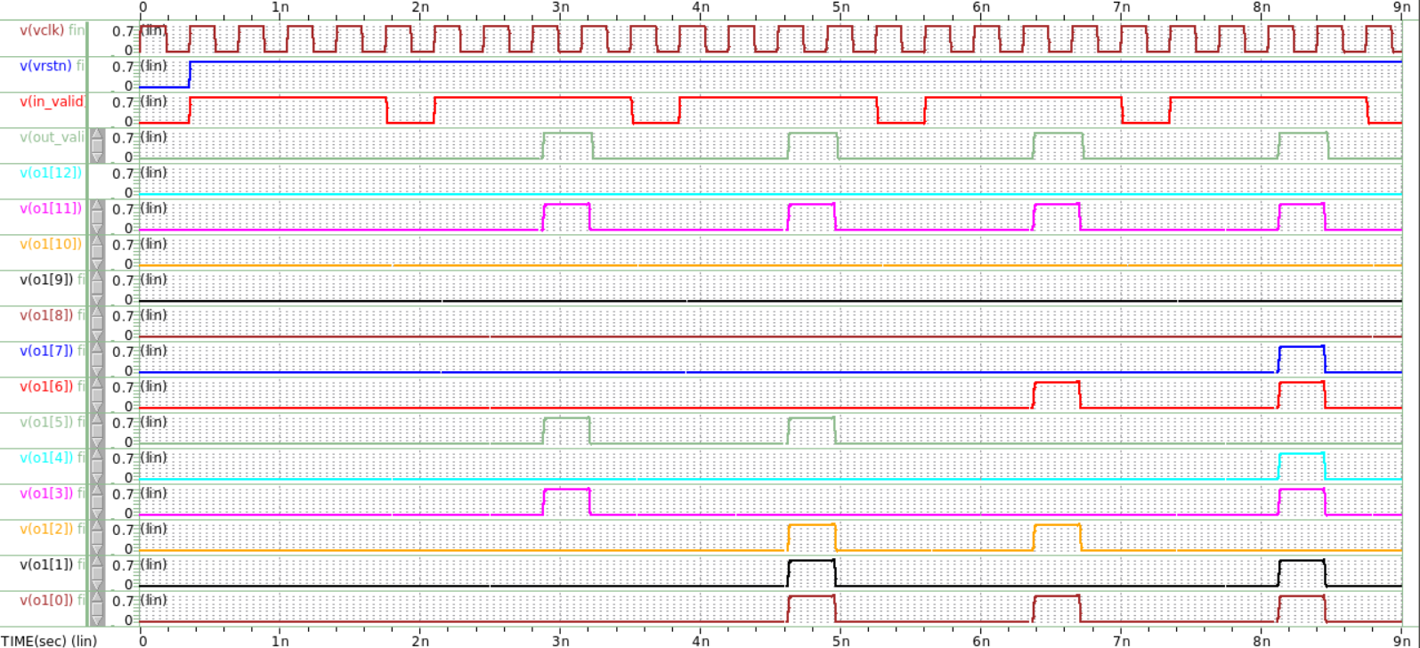
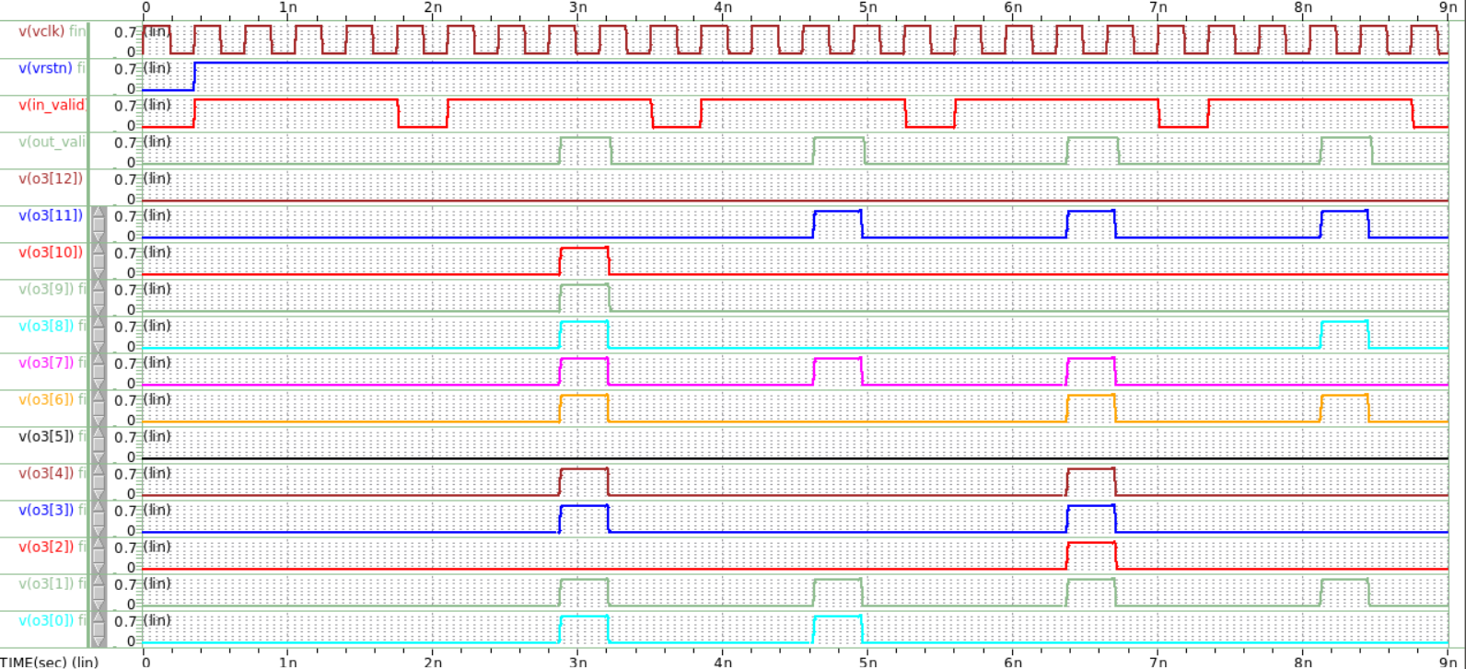
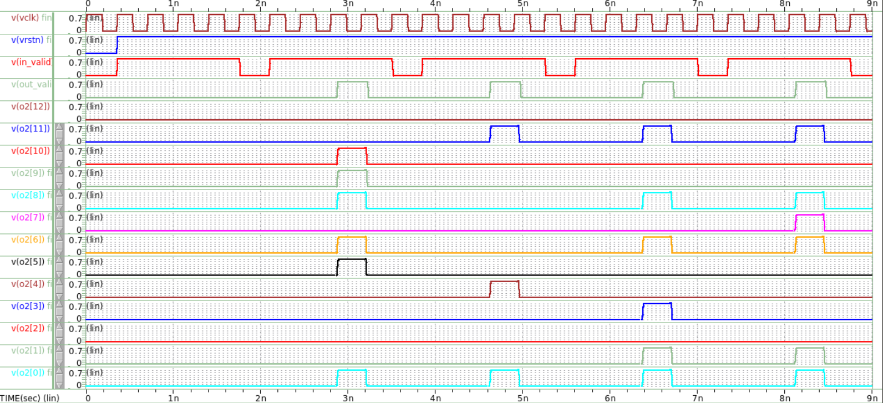
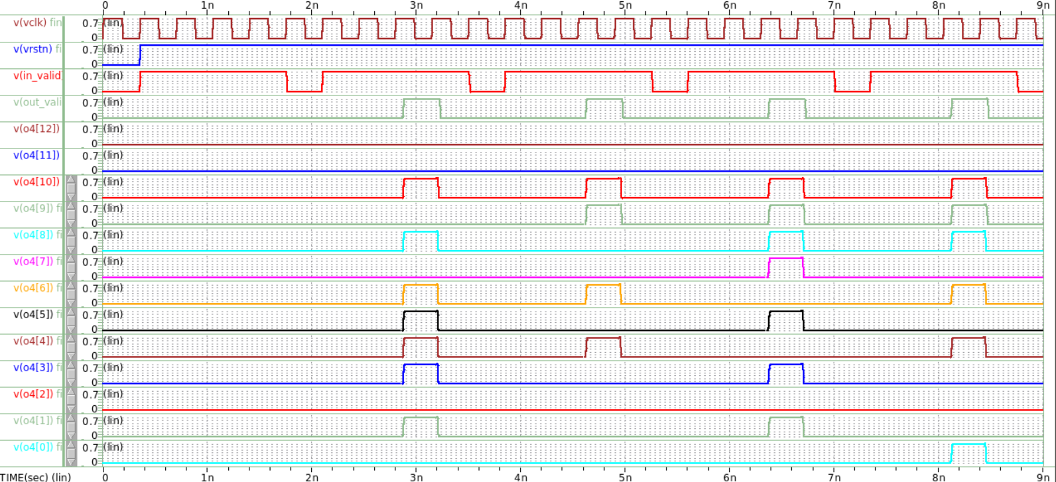
Adder tree ver.2
$$\left[\begin{matrix}\begin{matrix}{(O_{1})}_{1} & {(O_{2})}_{1} \\ {(O_{1})}_{2} & {(O_{2})}_{2}\end{matrix} & \begin{matrix}{(O_{3})}_{1} & {(O_{4})}_{1} \\ {(O_{3})}_{2} & {(O_{4})}_{2}\end{matrix} \\ \begin{matrix}{(O_{1})}_{3} & {(O_{2})}_{3} \\ {(O_{1})}_{4} & {(O_{2})}_{4}\end{matrix} & \begin{matrix}{(O_{3})}_{3} & {(O_{4})}_{3} \\ {(O_{3})}_{4} & {(O_{4})}_{4}\end{matrix}\end{matrix}\right]$$
0
0
0
0
0
0
0
0
1
1
1
1
0
1
1
1
0
0
0
0
1
0
0
0
0
0
0
0
1
0
0
0
0
0
0
0
1
0
0
1
輸出理論值
0
0
0
1
1
1
1
0
0
0
1
1
1
0
1
1
1
1
0
0
0
0
0
0
$$\left[\begin{matrix}\begin{matrix}2088 & 1889 \\ 2087 & 2065\end{matrix} & \begin{matrix}2011 & 1402 \\ 2179 & 1616\end{matrix} \\ \begin{matrix}2117 & 2379 \\ 2267 & 2499\end{matrix} & \begin{matrix}2270 & 1962 \\ 2370 & 1873\end{matrix}\end{matrix}\right]$$
0
0
0
1
1
0
1
0
1
0
0
1
1
0
1
0
0
1
1
0
0
0
1
0
0
1
0
1
1
1
1
1
0
1
1
1
1
1
0
0
(O1)₁=2088
(O1)₂=2087
(O1)₃=2117
(O1)₄=2267
(O3)₁=2011
(O3)₂=2179
(O3)₃=2270
(O3)₄=2370
O1 waveforms from Waveview.
O3 waveforms from Waveview.
系統輸出值
$$\left[\begin{matrix}\begin{matrix}2088 & 1889 \\ 2087 & 2065\end{matrix} & \begin{matrix}2011 & 1402 \\ 2179 & 1616\end{matrix} \\ \begin{matrix}2117 & 2379 \\ 2267 & 2499\end{matrix} & \begin{matrix}2270 & 1962 \\ 2370 & 1873\end{matrix}\end{matrix}\right]$$
0
0
0
0
0
0
0
0
0
1
1
1
0
0
0
0
1
0
0
0
1
1
1
1
1
0
0
0
0
1
1
1
1
0
1
1
1
0
1
1
由HSPICE模擬結果可見系統計算結果與理論計算值一致，本系統function正確。
0
0
0
1
0
0
1
0
1
0
1
1
1
1
0
1
1
0
0
0
1
0
1
0
0
1
0
0
1
1
0
1
0
0
1
0
1
0
1
0
0
0
0
0
0
0
0
0
0
0
1
1
1
0
1
0
1
1
1
1
0
0
0
1
(O2)₁=1889
(O2)₂=2065
(O2)₃=2379
(O2)₄=2499
(O4)₁=1402
(O4)₂=1616
(O4)₃=1962
(O4)₄=1873
O2 waveforms from Waveview.
O4 waveforms from Waveview.
Notes:
那通過gate level 的驗證後，接著看波型如圖，可以看出是算好四筆資料後再一次全部加起來, 功能正確. 有些微 delay，它經過一些 Delay 時間才穩定（十進位）。

Slide 24
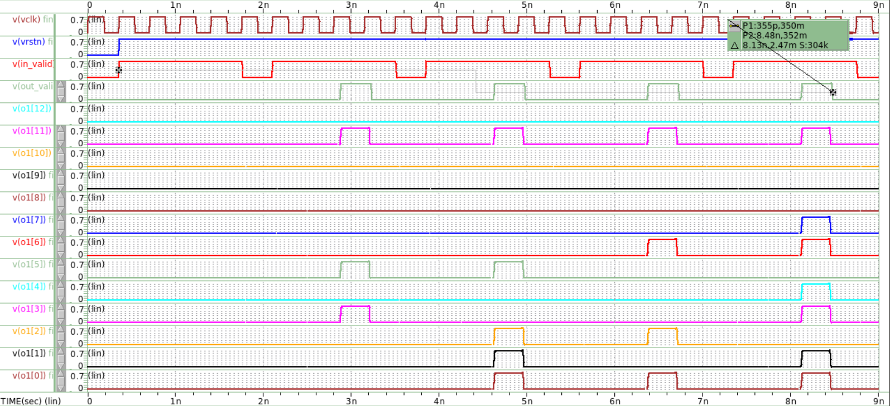
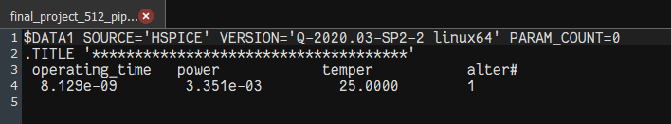



Adder tree ver.2
Operating time = $8.129×{10}^{−9}$
Results & Analysis
Using formula provided by TA in EX3,
Throughput (GOPS) =(Operations/operating time)
Operations: (number of multipliers during the operating time) x 2
Operating time: from positive edge of in_valid to negative edge of out_valid
Throughput (GOPS) of Serial Input_V2 ：
$$\frac{Operation}{operating time}=\frac{32×16×2}{8.129×{10}^{−9}}≈125. 969(GOPS)$$
Total power = $3.351×{10}^{−3}$
Energy efficiency (TOPS/Watt) of Serial Input_V2：
$$\frac{GOPS×{10}^{−3}}{Power}=\frac{125.969×{10}^{−3}}{3.351×{10}^{−3}}≈37.591(TOPS/W)$$
Operating time: 量測in_valid第1個rising edge到out_valid第4個falling edge所經時間
Total power:量測完整輸出一整組output signal的平均功率

Slide 25
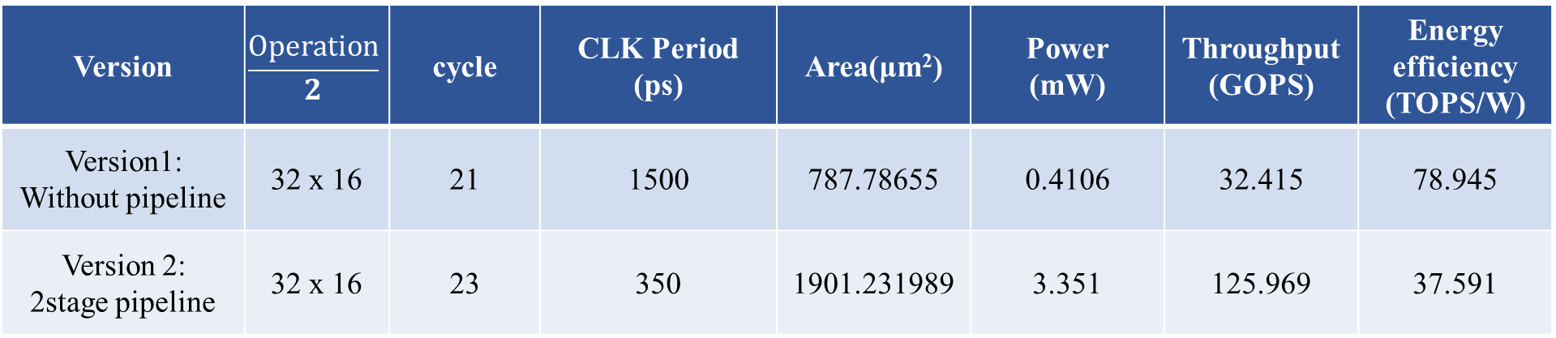
Conclusion
Version | $$\frac{Operation}{2}$$ | cycle | CLK Period (ps) | Area(μm²) | Power (mW) | Throughput (GOPS) | Energy efficiency (TOPS/W)
Version1: Without pipeline | 32 x 16 | 21 | 1500 | 787.78655 | 0.4106 | 32.415 | 78.945
Version 2: 2stage pipeline | 32 x 16 | 23 | 350 | 1901.231989 | 3.351 | 125.969 | 37.591
使用pipeline技術調整電路雖然可以達到更高的throughput，但因需額外加入更多cell來設法壓低clock period，因此整體的面積與功耗皆會上升。
因此可根據需求權衡設計方式，當我們需要相對高的throughput可以採用pipeline的設計，但若對功耗或面積有特別需求可權衡採用其他的設計手法。

Slide 26
Thanks for your attention

